Slide 1
Amazon products Recommendation
with Graph based models
Team members: Xueyuan Li Ruiqi Zhou
Vanderbilt University

Slide 2
Introduction
This project aims to develop an advanced recommendation system for Amazon's software product category using Graph Neural Networks (GNN) and NetworkX. By exploiting the relational data structure through GNN and NetworkX, the project seeks to provide highly personalized product recommendations, thereby improving customer satisfaction and potentially increasing sales.

Slide 3
Problem
How can the system utilize GNN and NetworkX(python package) to predict user ratings for products and provide recommendations?
How can NetworkX explore potential connections between users and identify as well as visualize the most centrally connected products and users to enrich the social dimensions and depth of the recommendation system?

Slide 4
Challenges
Rating Prediction Accuracy: Tackling the challenge of sparse data to enhance the accuracy of user preference predictions using GNN.
Efficiency in Similarity Calculation: Employing efficient algorithms to process large-scale data swiftly, calculating product similarities.
Complexity in User Connections: Analyzing extensive social graph data to effectively explore and understand user connections and dynamics within the network.

Slide 5
Data
Source: Amazon 2018 software purchases dataset
Core Selection: Utilized a 5-kcore method to ensure all data points in the dataset have a minimum of five connections, enhancing the robustness and relevance of our analysis.
Datasets:
Reviews: 12,805 entries capturing user feedback and ratings.
Metadata: 26,790 entries detailing product information.
Nodes:
Product Nodes: 21,639
User Nodes: 1,826
Edges: Connections illustrating various relationships:
Review Text: Textual comments provided by users for each product.
Also Bought: Links indicating products frequently purchased together, suggesting purchasing patterns.
Descriptions: Basic information about each product, including features and specifications.
Category: The specific category to which each product belongs.
Ratings: Numerical ratings given to products by users, used for evaluating product popularity and user satisfaction.

Slide 6
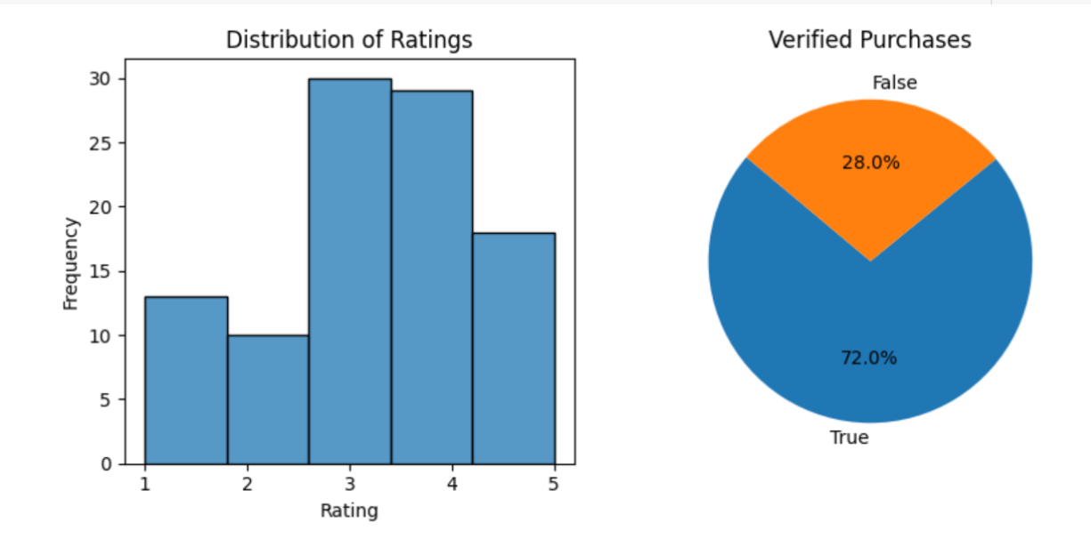
EDA - distribution of ratings

Slide 7

EDA - word cloud of categories

Slide 8
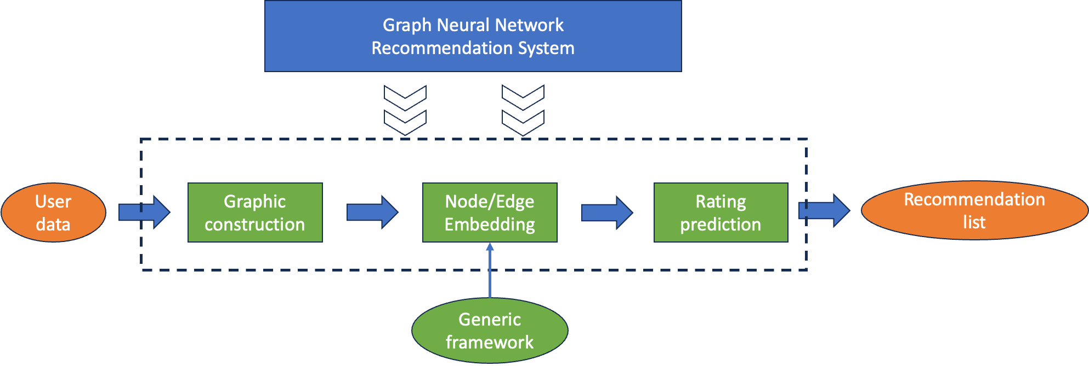
Methods
Approach:
Data Preparation: Utilize user interaction data with products (ratings, reviews, etc.) to form a user-item interaction graph.
Model Implementation: Implement a GNN architecture to learn low-dimensional embeddings for users and products based on historical interactions.
Rating Prediction: Use the embeddings to predict ratings for products not yet rated by a user.
Recommendation Generation:
Product Recommendations: Identify top 10 products for each user by predicting potential ratings and ranking products accordingly.
Similarity Analysis: Apply cosine similarity on product embeddings to find top similar products for each item.
A.Graph Neural Network (GNN) for Recommendations
Notes:
Our first method is GNN, We implemented a GNN architecture designed to learn low-dimensional embeddings for both users and products, based on their historical interactions.
Then we make recommendations by using these embeddings to predict ratings and also find similar products for each items.

Slide 9

Methods
B. NetworkX for Graph-based Recommendations
Approach:
Graph Construction: Construct a bipartite graph where nodes represent users and products, and edges represent interactions such as purchases or ratings.
Link Prediction:
User Connections: Predict potential links between users (e.g., User A and User B) based on common behaviors or shared product interactions.
Centrality Analysis:
Top Products: Determine products with the highest degree of centrality to identify the most connected and potentially influential products.
Top Users: Identify users with the highest connectivity, suggesting influence or centrality within the network.
Visualization:
Visualize the subgraphs of top connected products and users to illustrate the network's key components and their interactions.
Notes:
Secondly, we use package NetworkX to build a binary graph where nodes represent users and products, and edges represent interaction such as purchase or ratings.
Based on this graph, we can first predict the potential links between users, and find the top connected users and products, which can identify influential products and central users.

Slide 10
Experiments
A.Graph-based recommendation system based on Graph Neural Network (GNN) & TF-IDF
Find Top product recommendations for each user by predicting ratings. *
Find Top Similar Products for each items based on cosine similarity.*
B. Graph-based recommendation system based on NetworkX
Find Top product recommendations for each user by predicting ratings. * - Average of Neighbor Ratings
Predict potential links between User A and User B. (Additional Exploration)
Find Top connected users and their Top recommended products. (Additional Exploration)
Notes:
There are several experiments, I will go through each of them in next part.
"Getting the top connected users with connected products" refers to identifying the most influential users and their associated products within a network, based on the connections between them.

Slide 11
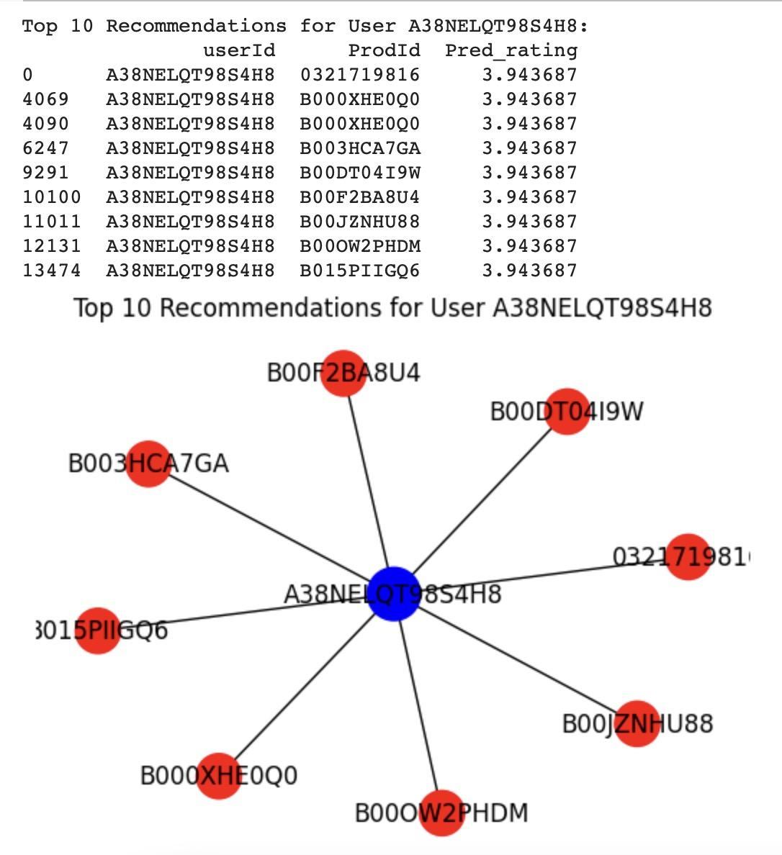
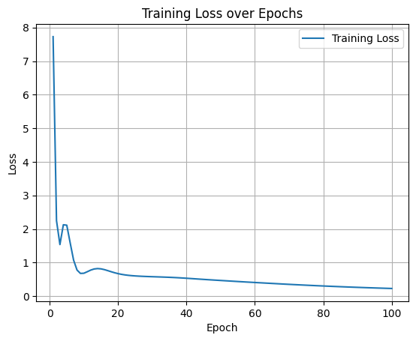
Results
A.Graph Neural Network (GNN)
User-Item Recommendation
Find Top product recommendations for each user by predicting ratings.

Slide 12
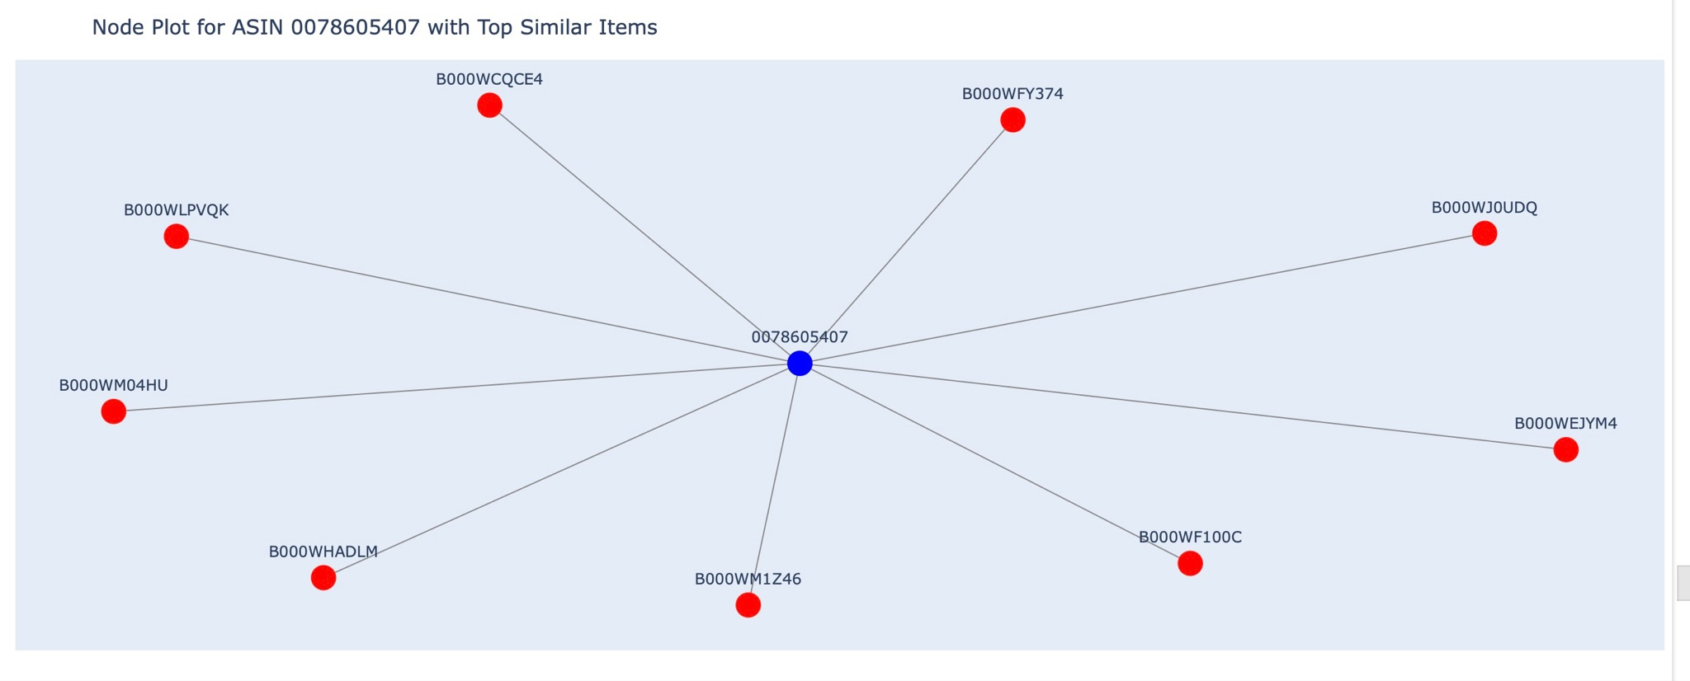
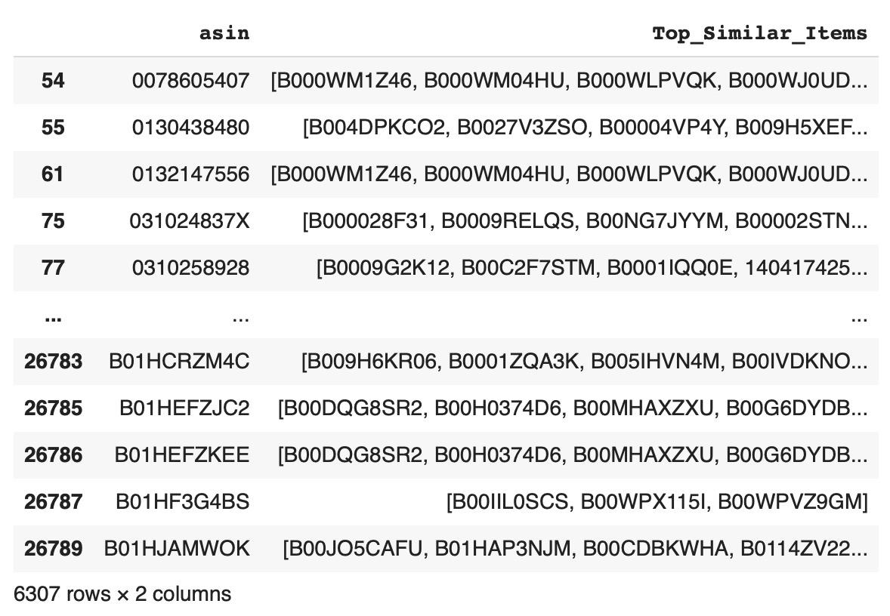
Results
A.Graph Neural Network (GNN)
(2) Item-Item Similarity
Find Top Similar Products for each items based on cosine similarity
Notes:
Then we calculate the cosine similarity between items to find the top similar products. We first use TF-IDF for feature extraction.

Slide 13
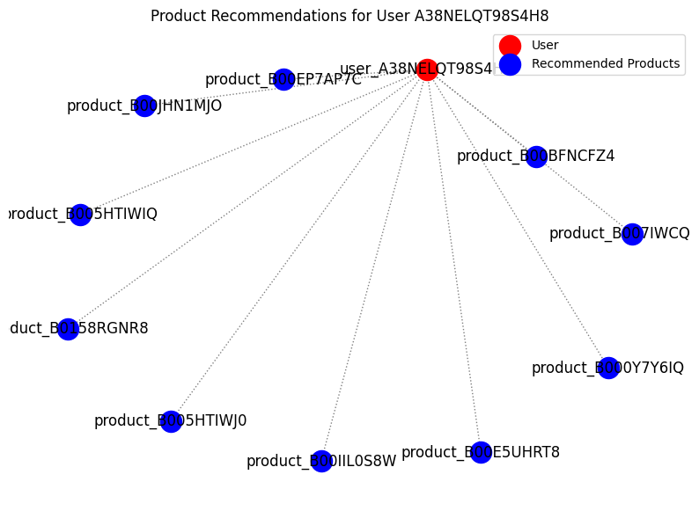
Results
B. NetworkX
(1) Find Top product recommendations for each user by predicting ratings.
compute the average rating of the product based on the ratings given by other users.
Notes:
It is quite similar with the GNN, but we don’t use any model to train , we directly compute the average rating of the product based on the ratings given by other users.

Slide 14
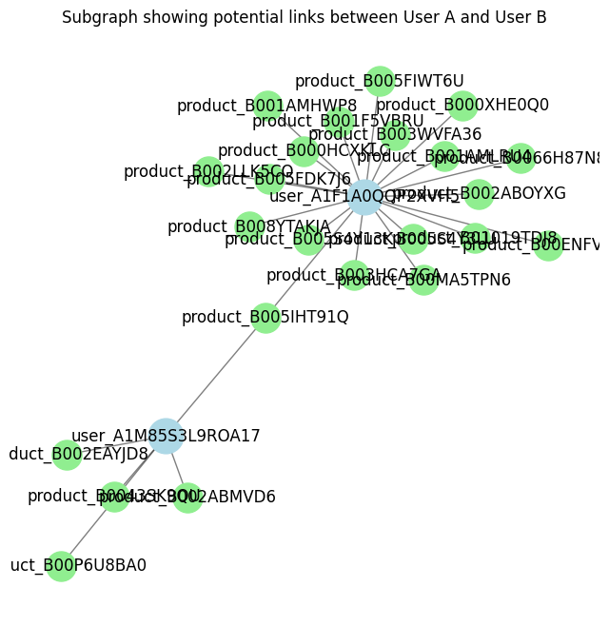
Results
B. NetworkX
(2) Predict potential links between User A and User B.
user1_node = "user_A1M85S3L9ROA17"
user2_node = "user_A1F1A0QQP2XVH5"
Neighbors of A1M85S3L9ROA17: ['product_B002ABMVD6', 'product_B002EAYJD8', 'product_B0043SK9QU', 'product_B00P6U8BA0', 'product_B005IHT91Q']
Neighbors of A1F1A0QQP2XVH5: ['product_B000HCXKLC', 'product_B000XHE0Q0', 'product_B001AMHWP8', 'product_B001AMLRU4', 'product_B001F5VBRU', 'product_B002ABOYXG', 'product_B002LLK5CO', 'product_B003HCA7GA', 'product_B003WVFA36', 'product_B005FDK7J6', 'product_B005FIWT6U', 'product_B005S4Y3LU', 'product_B005S4Y13K', 'product_B0066H87N8', 'product_B008YTAKJA', 'product_B00ENFVLAQ', 'product_B00MA5TPN6', 'product_B01019TDJ8', 'product_B005IHT91Q']
Predict links : If both are in the graph, calculate link prediction metrics
{'Common Neighbors': 1, 'Jaccard Coefficient': 0.043478260869565216,
'Adamic-Adar Index': 0.5581106265512472, 'Preferential Attachment': 95}
Notes:
Given two user nodes, then we can get their neighbors, and predict the potential links by calculating link prediction metrics.
Jaccard Coefficient: Measures similarity between the sets of neighbors of two nodes.
Adamic-Adar Index: Weighs the common neighbors by the logarithm of the degree of the common neighbors.
Preferential Attachment: Predicts that the probability of a new link forming between two nodes is proportional to the product of the number of neighbors or degrees of the two nodes.

Slide 15
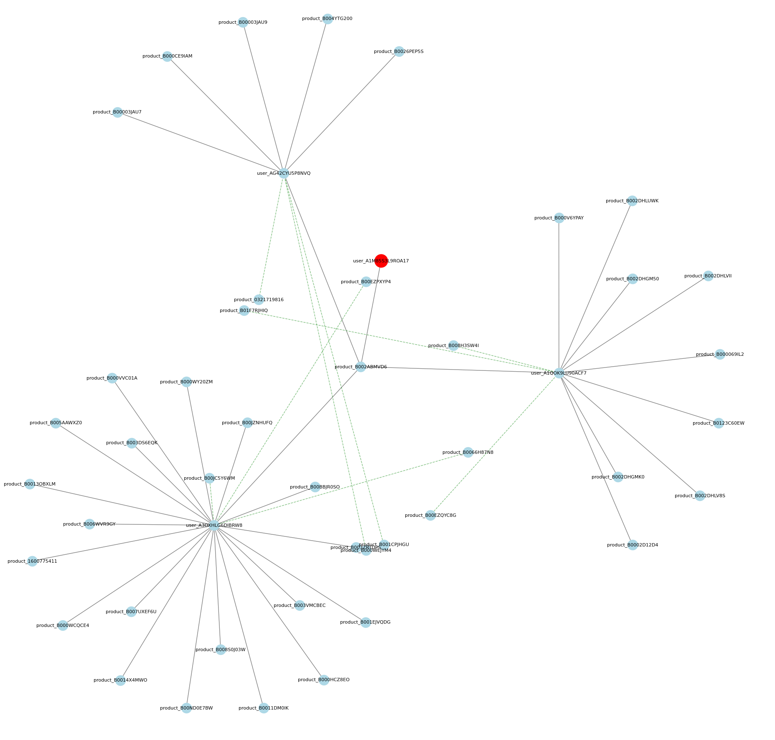
Results
B. NetworkX
(3) Find Top 3 connected users of a given user ("A1F1A0QQP2XVH5") and their Top 3 recommended products. - Jaccard coefficient
Top connected users for 'A1F1A0QQP2XVH5':
['user_A225G2TFM76GYX', 'user_A1YLJG0TWVI5JR', 'user_ANGGNFE8DXGYC']
Top 3 recommended products for 'A1F1A0QQP2XVH5':
['product_B00F8K9MZQ', 'product_B000X86ZAS', 'product_B00MYXTCGY']
Top 3 recommended products for 'A225G2TFM76GYX':
['product_B008H3SW4I', 'product_B004XO6V1G', 'product_B00MYXTCNC']
Top 3 recommended products for 'A1YLJG0TWVI5JR':
['product_B001AMPP0W', 'product_B000WR2F2M', 'product_B000FK88JK']
Top 3 recommended products for 'ANGGNFE8DXGYC':
['product_B015724OVG', 'product_B00EZPXYP4', 'product_B00EZQYC8G']
Notes:
Based on link prediction, we expand to …
"Getting the top connected users with connected products" refers to identifying the most influential users and their associated products within a network, based on the connections between them.
How Recommendations Are Made? We identify a function: to recommend new products to a user based on the similarity of users' interactions with products. (1) First identifies similar users. Which is computed by Jaccard coefficient. higher similarity leads to stronger recommendations. (2) Each potential product recommendation is scored based on the sum of its Jaccard coefficients from different similar users.
Connected Users? Identify a function: users most closely connected to a given user based on the number of shared products they have reviewed or purchased. (1) Count Shared Products (also reviewed or also purchased), (2) sort the number of shared products for each user, and select the top connected users.

Slide 16
Results
Compare the product recommendation evaluations based on the 'pred_rating'.
Models | RMSE | MAE | Precision | Recall
GNN | 0.2181 | 0.1695 | 0.8738 | 0.9797
Graph-based Network (NetworkX) | 1.1165 | 0.8223 | 0.8898 | 0.6889
Train
Models | RMSE | MAE | Precision | Recall
GNN | 0.7765 | 0.6567 | 0.8353 | 0.7167
Graph-based Network (NetworkX) | 1.2561 | 0.9198 | 0.8317 | 0.6523
Test
Notes:
Compared with two methods, we find that GNN has better performance than Graph based network only using NetworkX.

Slide 17
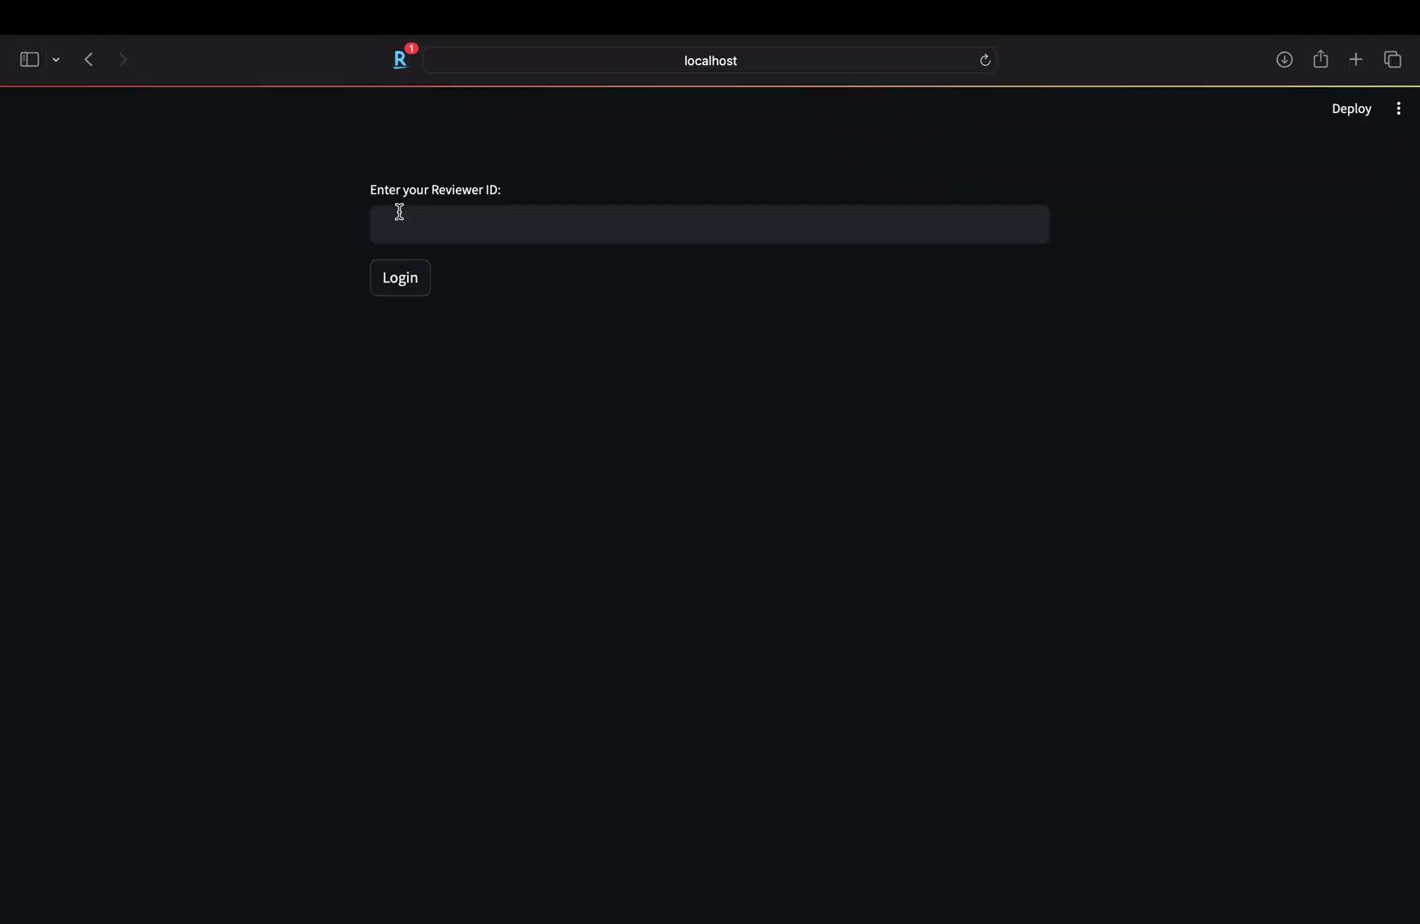
Demo

Slide 18
Conclusion
Advanced Personalization: Through our GNN model, we have been able to deliver top 10 personalized product recommendations.
Deep Network Insights: Utilizing NetworkX, we've illuminated powerful connections within the user-product graph
Scalability and Efficiency: Our models handle large-scale data efficiently, maintaining high computational performance.

Slide 19
Future Work
Model Optimization
Enhanced User Insights
Scalability Improvements
Broader Product Categories

Slide 20
Q&A

